Slide 1
Data Science
CSE-4077

Slide 2
Types of Data Sets
Record
Relational records
Data matrix, e.g., numerical matrix, crosstabs
Document data: text documents: term-frequency vector
Transaction data
Graph and network
World Wide Web
Social or information networks
Molecular Structures
Ordered
Video data: sequence of images
Temporal data: time-series
Sequential Data: transaction sequences
Genetic sequence data
Spatial, image and multimedia:
Spatial data: maps
Image data:
Video data:

Slide 3
Data Objects
Data sets are made up of data objects.
A data object represents an entity.
Examples:
sales database: customers, store items, sales
medical database: patients, treatments
university database: students, professors, courses
Also called samples , examples, instances, data points, objects, tuples.
Data objects are described by attributes.
Database rows -> data objects; columns ->attributes.

Slide 4
Attributes
Attribute (or dimensions, features, variables): a data field, representing a characteristic or feature of a data object.
E.g., customer _ID, name, address
Types:
Nominal
Binary
Numeric: (Discrete, Continuous)
Interval-scaled
Ratio-scaled

Slide 5
Attribute Types
Nominal: categories, states, or “names of things”
Hair_color = {auburn, black, blond, brown, grey, red, white}
marital status, occupation, ID numbers, zip codes
Binary
Nominal attribute with only 2 states (0 and 1)
Symmetric binary: both outcomes equally important
e.g., gender
Asymmetric binary: outcomes not equally important.
e.g., medical test (positive vs. negative)
Convention: assign 1 to most important outcome (e.g., HIV positive)
Ordinal
Values have a meaningful order (ranking) but magnitude between successive values is not known.
Size = {small, medium, large}, grades, army rankings

Slide 6
Numeric Attribute Types
Quantity (integer or real-valued)
Interval
Measured on a scale of equal-sized units
Values have order
E.g., temperature in C˚or F˚, calendar dates
No true zero-point
Intangible
We can add and subtract, but we cannot multiply, divide or calculate ratios.
Ratio
Inherent zero-point
tangible
We can speak of values as being an order of magnitude larger than the unit of measurement (10 K˚ is twice as high as 5 K˚).
e.g., temperature in Kelvin, length, counts, monetary quantities

Slide 7
General Characteristics of Data Sets
Dimensionality
The dimensionality of a data set is the number of attributes that the objects in the data set have.
In a particular data set if there are high number of attributes, then it can become difficult to analyze such a data set. This problem is referred as Curse of Dimensionality.
Sparsity
For some data sets, most attributes of an object have values of 0; in many cases fewer than 1% of the entries are non-zero. Such a data is called sparse data or it can be said that the data set has Sparsity.
Resolution
Resolution is the smallest change that can be measured.
Finer resolution reduces rounding errors. However, resolution that is too coarse may add rounding errors.

Slide 8
Repositories of Data Sets
https://www.kaggle.com/datasets
https://www.kdnuggets.com/datasets/index.html
https://archive.ics.uci.edu/ml/datasets.php
https://github.com/datasets
https://github.com/niderhoff/nlp-datasets
https://datasetsearch.research.google.com/
https://data.worldbank.org/
https://towardsdatascience.com/data-repositories-for-almost-every-type-of-data-science-project-7aa2f98128b

Slide 9
Getting Data
Normally in your DS tasks you will be either:
Given data
Required to download data
Required to scrape data of the web
Least intensive
Most intensive

Slide 10
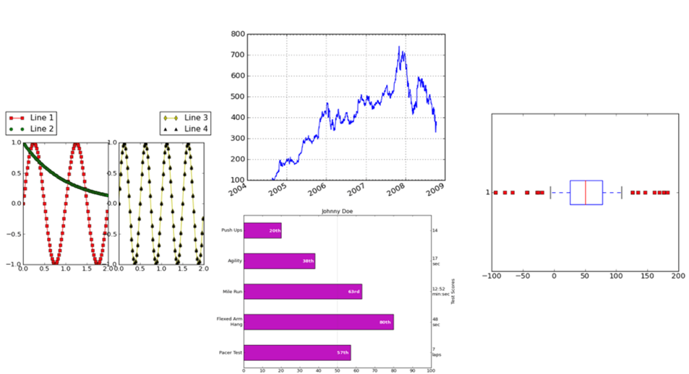
Visualization

Slide 11
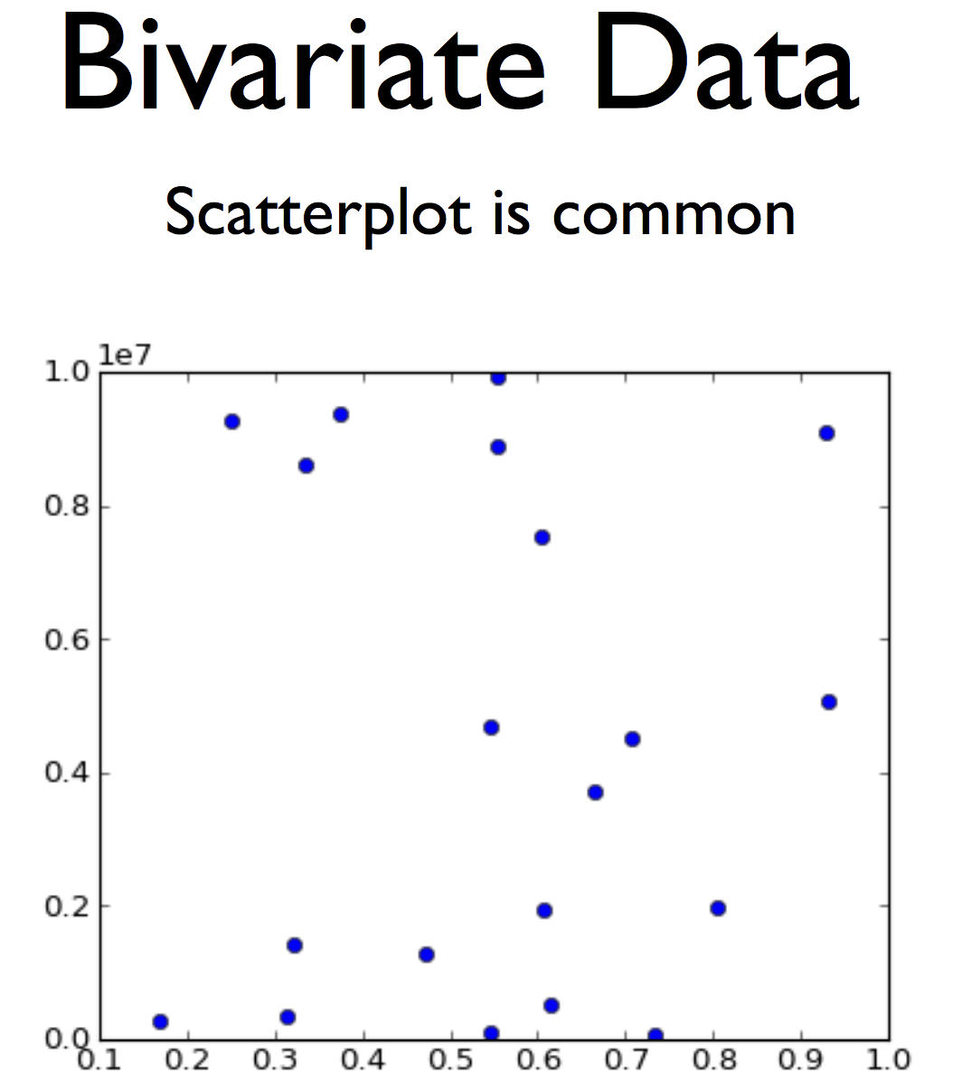

Slide 12
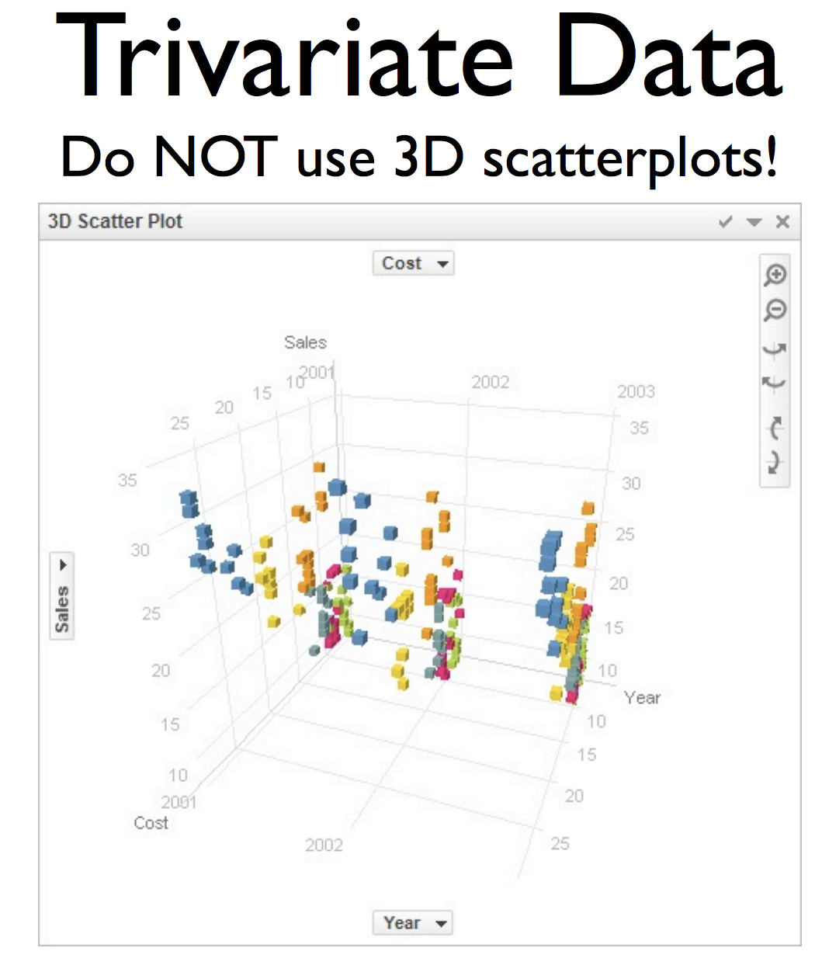

Slide 13
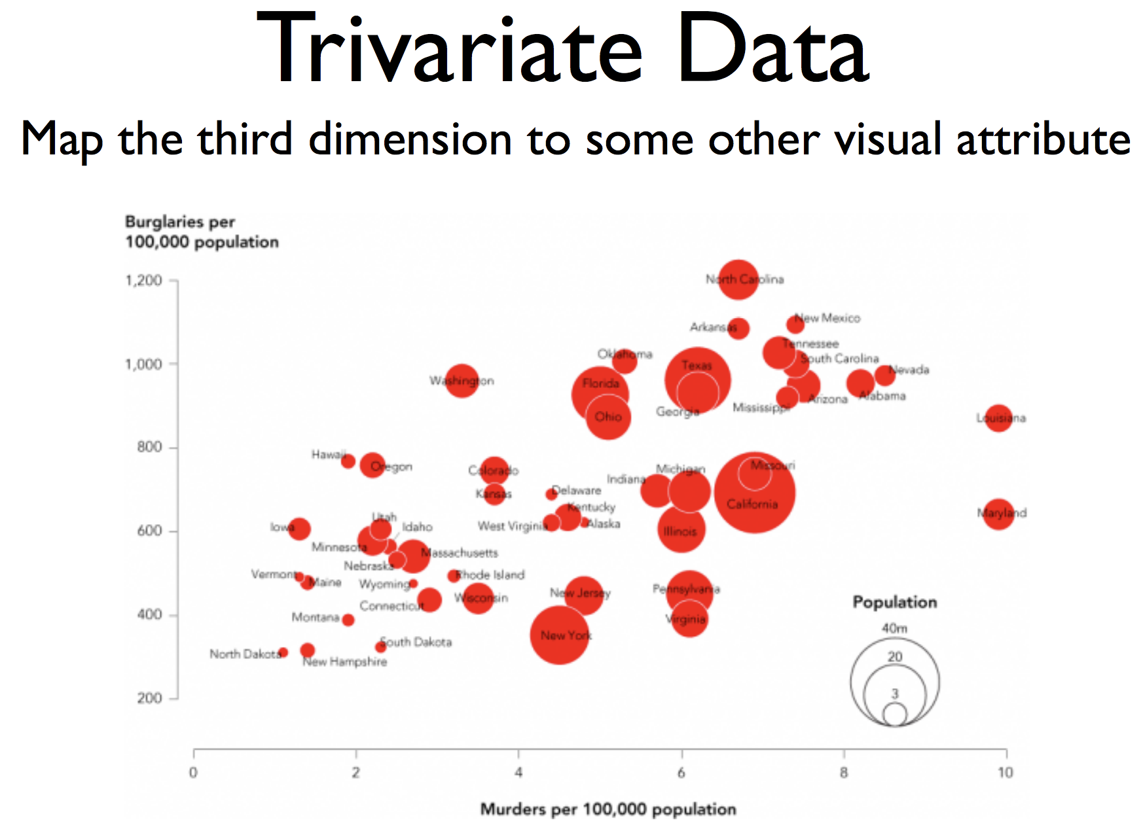

Slide 14
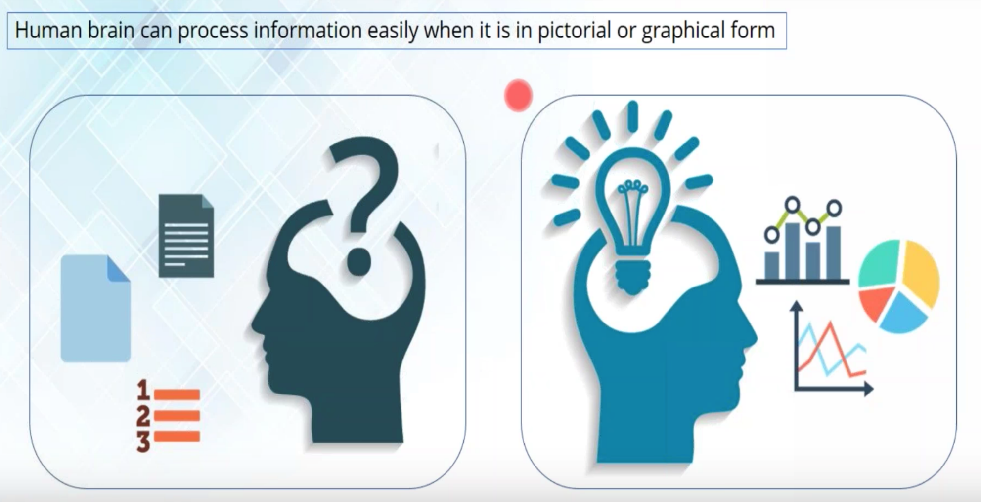
Why Visualize Data?

Slide 15
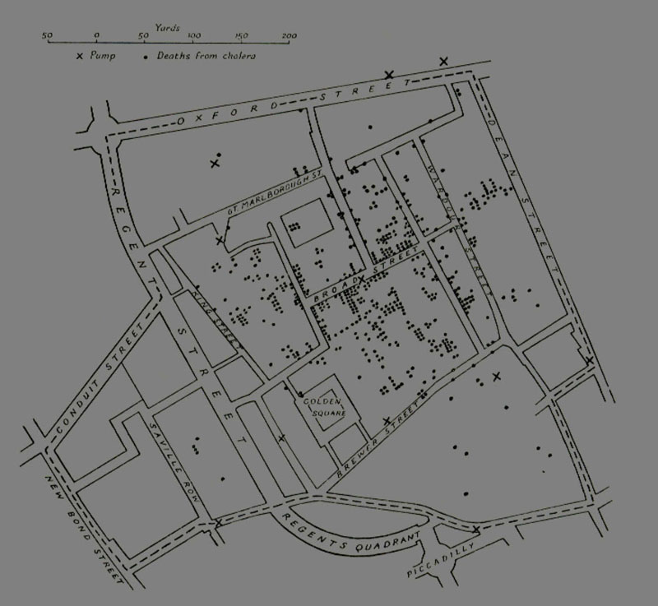
John Snow
Location of deaths in the 1854 London Cholera Epidemic.
X marks the locations of the water pumps
Dr. John Snow
Notes:
Tufte (1983, p. 24) says,"Snow observed that cholera occurred almost entirely among those who lived near (and drank from) the Broad Street water pump. He had the handle of the contaminated pump removed, ending the neighborhood epidemic which had taken more than 500 lives."

Slide 16
Anscombe’s Quartet

Slide 17
Anscombe’s Quartet (2)
mean of the x values = 9.0
mean of the y values = 7.5
equation of the least-squared regression line:
y = 3 + 0.5x
sums of squared errors (about the mean) = 110.0
regression sums of squared errors
(variance accounted for by x) = 27.5
residual sums of squared errors
(about the regression line) = 13.75
correlation coefficient = 0.82
coefficient of determination = 0.67

Slide 18
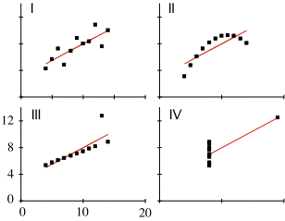
Anscombe’s Quartet (3)
Notes:
Look at your data before you analyze it

Slide 19
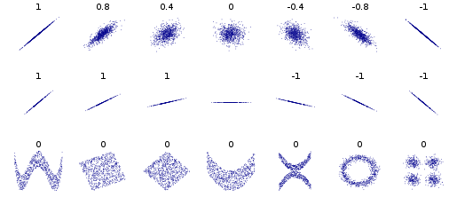
Another example: Pearson Correlation

Slide 20
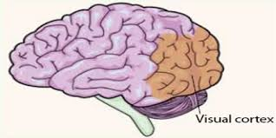
Other reasons?
Visualization is the highest bandwidth channel into the human brain [Palmer 99]
The visual cortex is the largest system in the human brain; it’s wasteful not to make use of it.
As data volumes grow, visualization becomes a necessity rather than a luxury.
“A picture is worth a thousand words”

Slide 21
What is the rate-limiting step in data understanding?
Amount of data in the world
Processing power: Moore’s Law
Notes:
And processing power, either as raw processor speed or via novel multi-core and many-core architectures, is also continuing to increase exponentially…

Slide 22
What is the rate-limiting step in data understanding?
Amount of data in the world
Processing power: Moore’s Law
Human cognitive capacity
Notes:
… but human cognitive capacity is remaining constant. How can computing technologies help scientists make sense out of these vast and complex data sets?

Slide 23

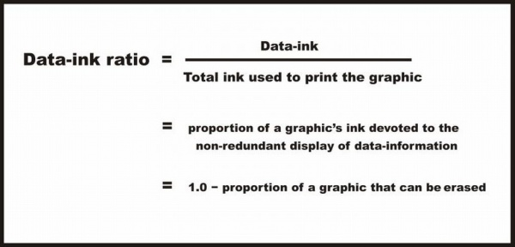
What makes a good visualization?
Edward Tufte: Maximize the data-ink ratio

Slide 24
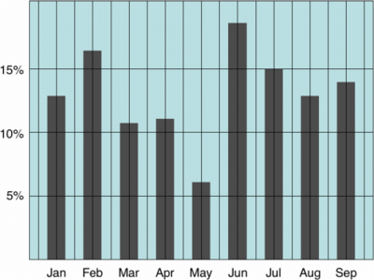
Example: High or Low Data Ink ratio?

Slide 25
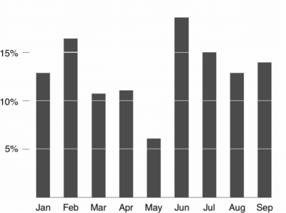
Example: High or Low Data Ink ratio?

Slide 26
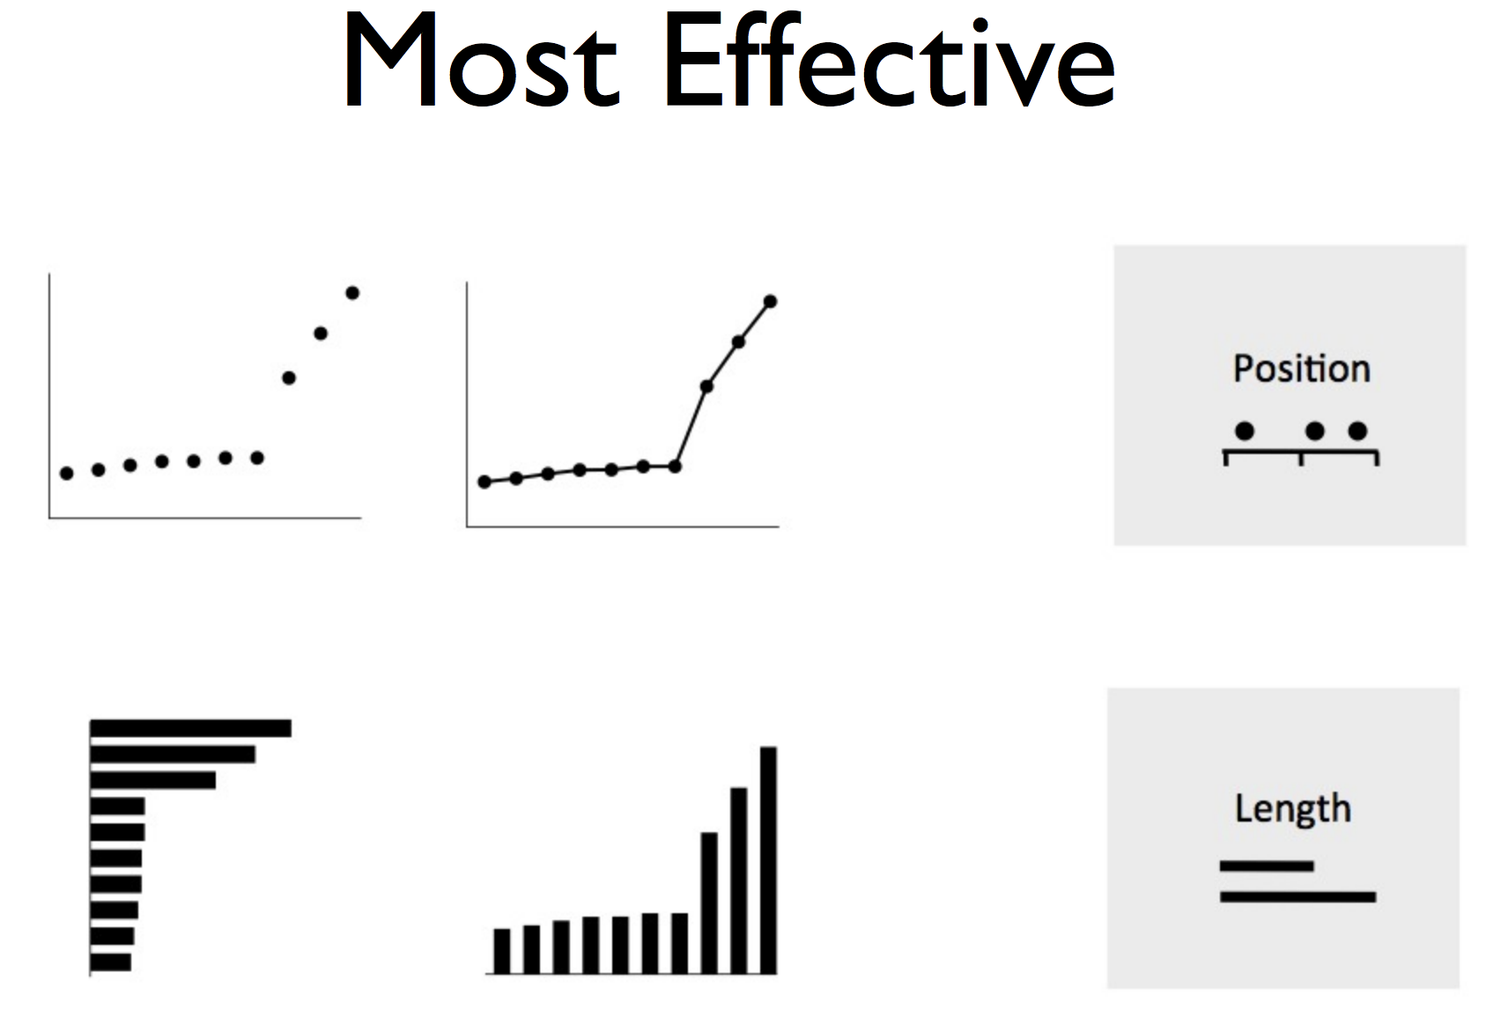

Slide 27
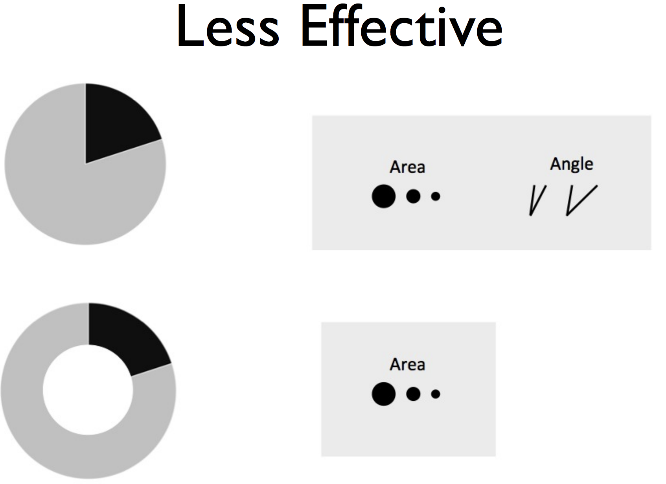

Slide 28
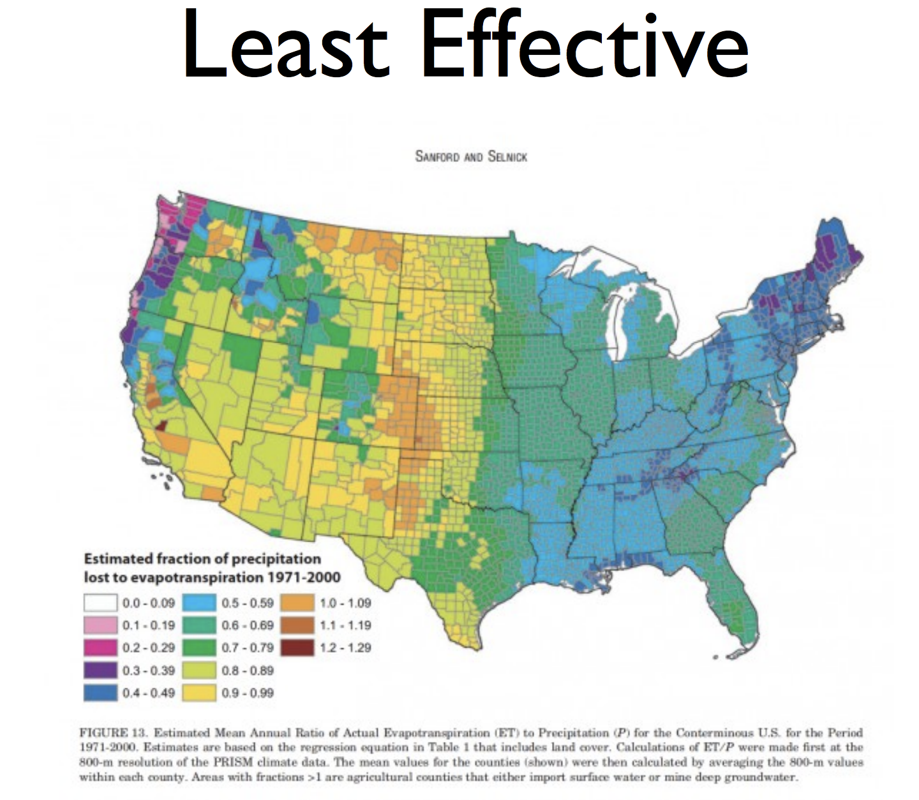

Slide 29
Role of Perception
Human visual system has limitation
These limitations may lead to wrong/incomplete analysis of graphs
Understanding how we see leads to better display
Misleading graphics needs to be avoided

Slide 30
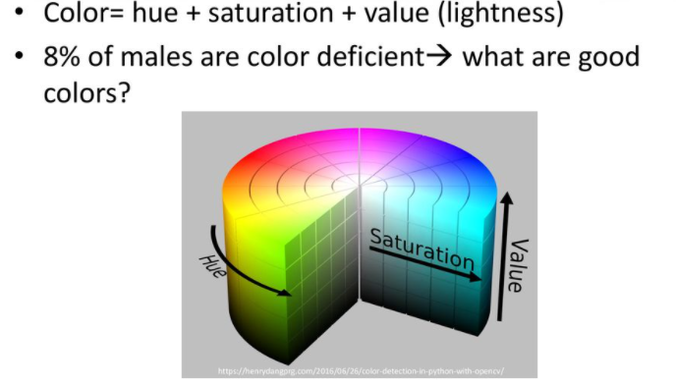
Colors

Slide 31
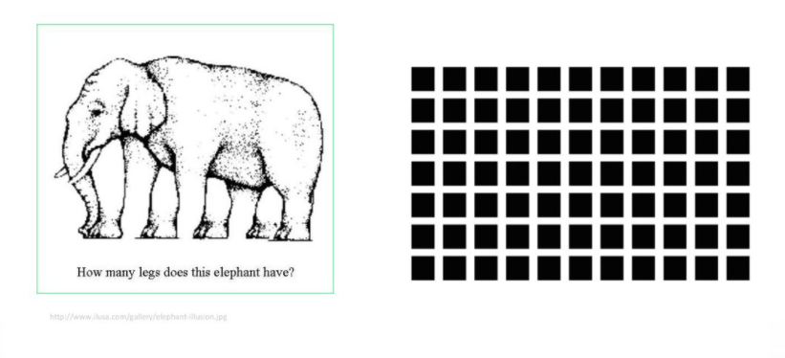
Illusion

Slide 32
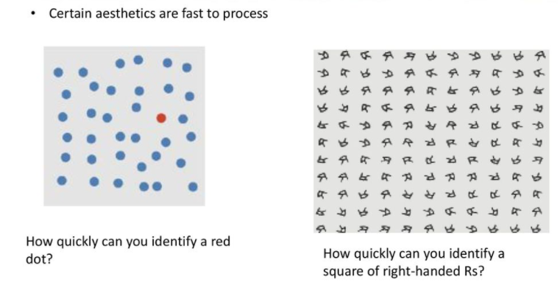
Pre-attentive processing

Slide 33
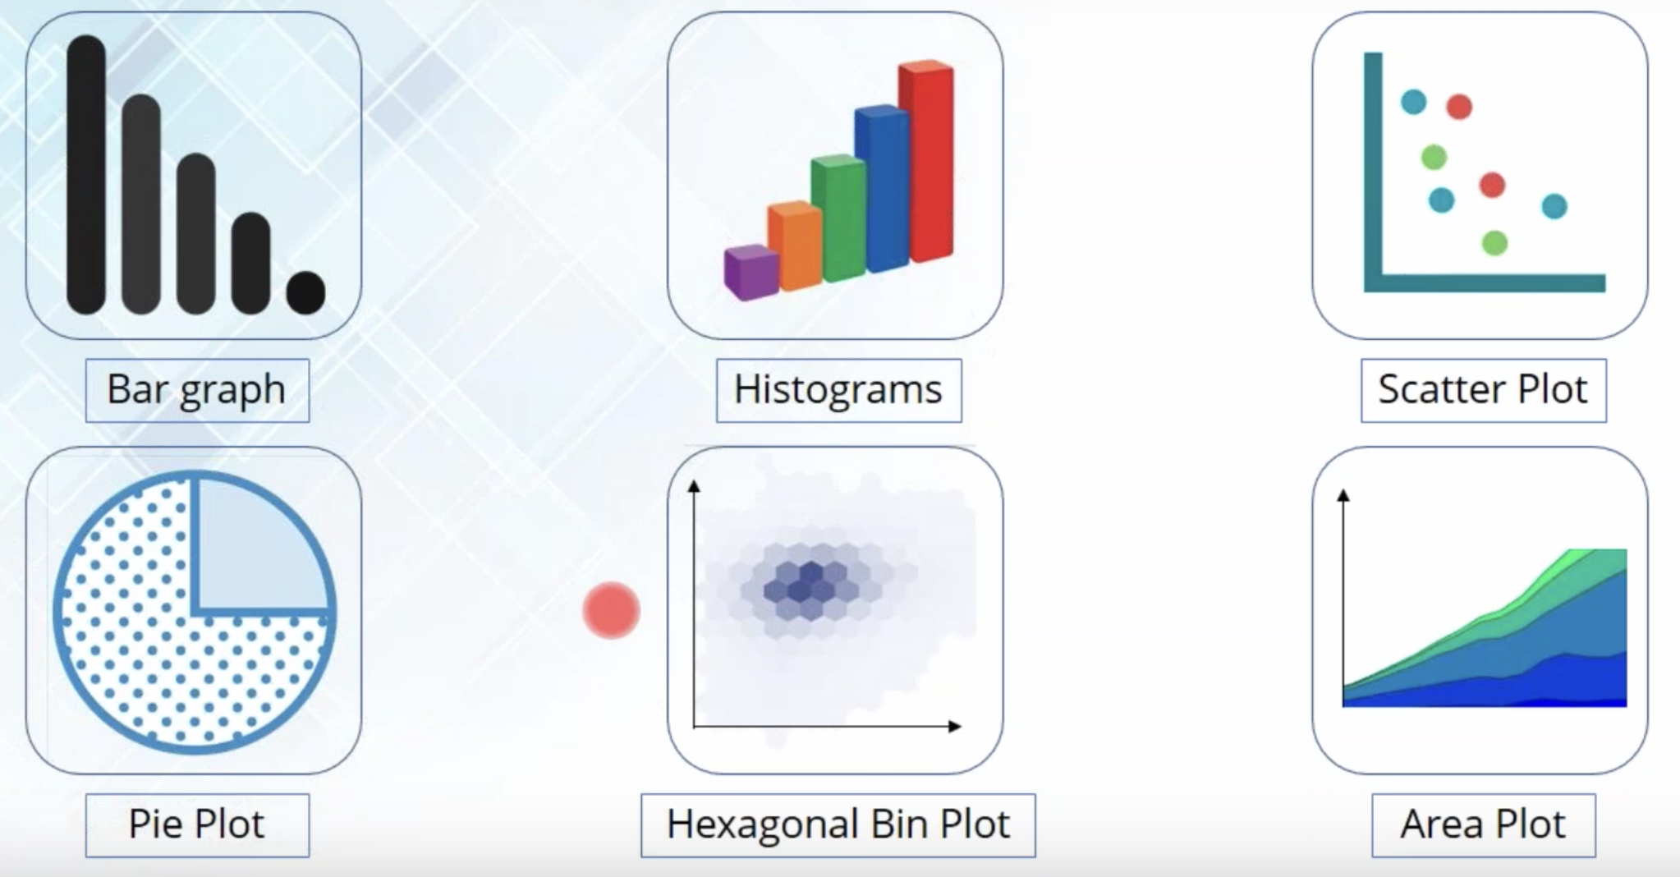
Plots/Graphs

Slide 34
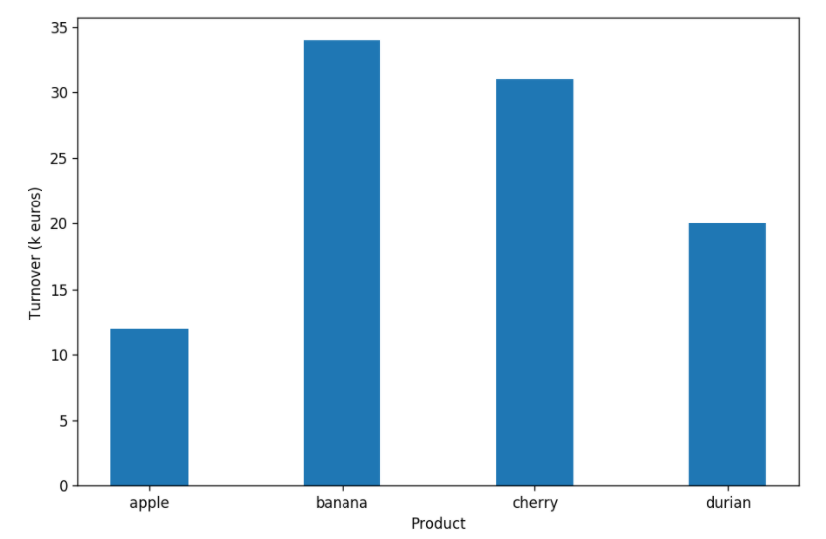
Bar chart
A bar chart or bar graph is a chart or graph that presents categorical data with rectangular bars with heights or lengths proportional to the values that they represent. The bars can be plotted vertically or horizontally.
When to use it ?
Compare categorical data.
Comparisons among discrete categories.
One axis of the chart shows the specific categories being compared, and the other axis represents a measured value.

Slide 35
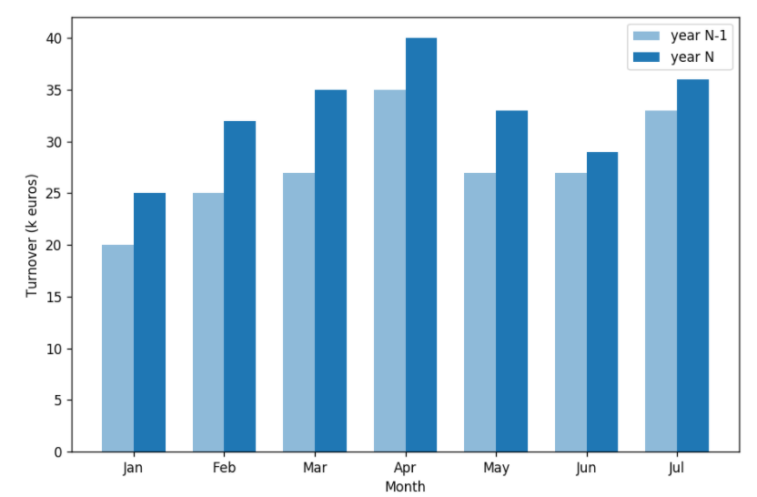
Grouped Bar chart
In a grouped bar chart, for each categorical group there are two or more bars. These bars are color-coded to represent a particular grouping.
When to use it ?
To represent and compare different categories of two or more groups.

Slide 36
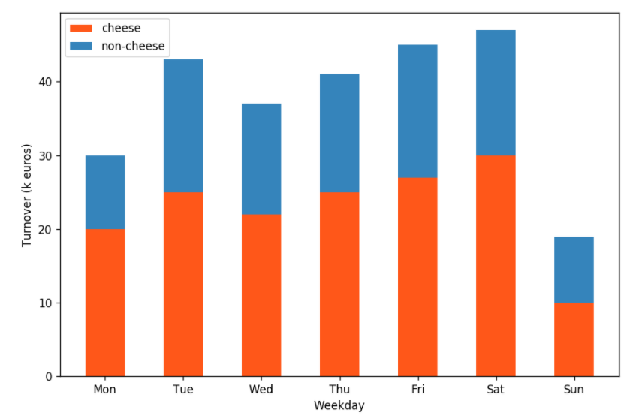
Stacked Bar chart
The stacked bar chart stacks bars that represent different groups on top of each other. The height of the resulting bar shows the combined result of the groups.
When to use it ?
To compare the totals and one part of the totals.
If the total of your parts is crucial, stacked column chart can work well for dates.

Slide 37
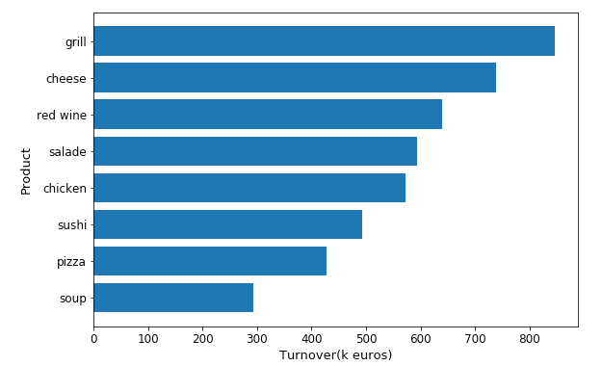
Vertical Bar chart
The horizontal bar chart is the same as a vertical bar chart only the x-axis and y-axis are switched.
When to use it ?
You need more room to fit text labels for categorical variables.
When you work with a big dataset, horizontal bar charts tend to work better in a narrow layout such as mobile view.

Slide 38
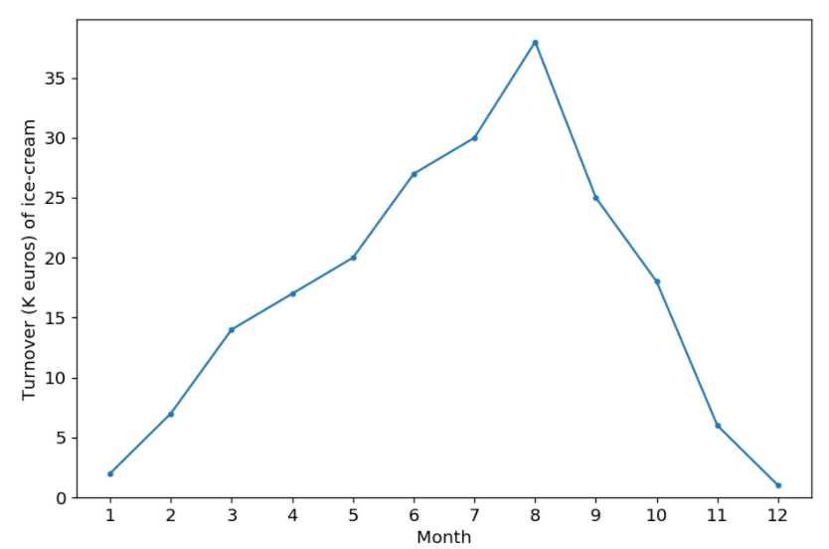
Line chart
A line chart or line graph is a type of chart which displays information as a series of data points called ‘markers’ connected by straight line segments. A line chart is often used to visualize a trend in data over intervals of time – a time series – thus the line is often drawn chronologically.
When to use it ?
Track changes over time
x-axis displays continuous variables
Y-axis displays measurement

Slide 39
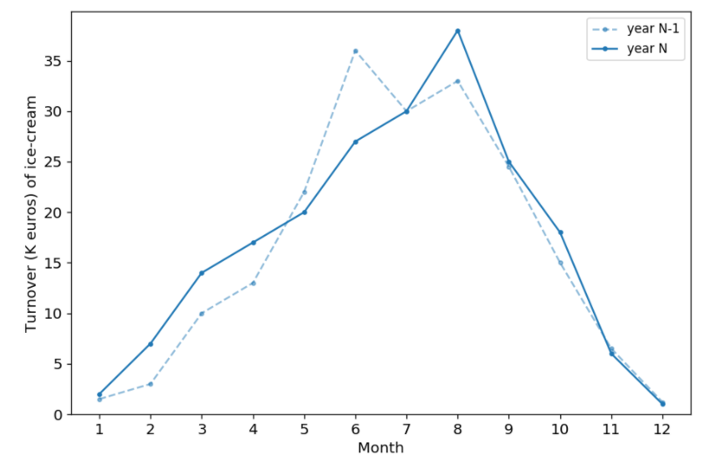
Line chart with multiple lines
When to use it ?
Compare different subjects during the same period.

Slide 40
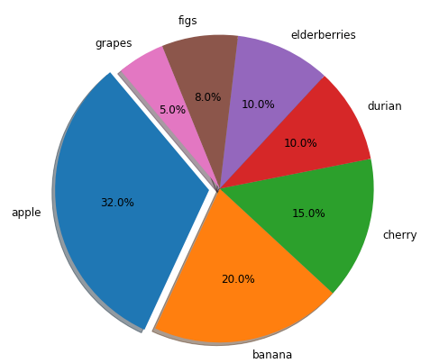
Pie Chart
A pie chart (or a circle chart) is a circular statistical graphic which is divided into slices to illustrate numerical proportion. In a pie chart, the arc length of each slice (and consequently its central angle and area), is proportional to the quantity it represents.
When to use it ?
Show percentage or proportional data.
Less than 7 categories.
Display data that is classified into nominal or ordinal categories.
Try to use positive values.

Slide 41
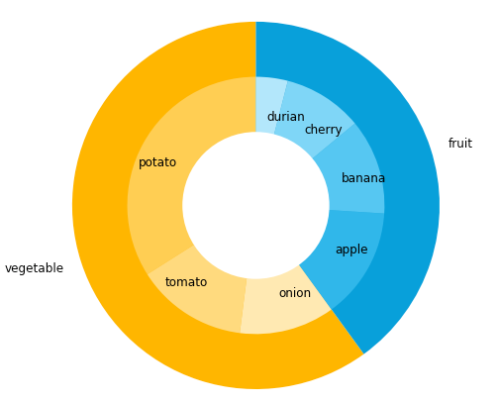
Nested Pie Chart
A nested pie chart or multi-level pie chart allows you to incorporate multiple levels or layers into your pie. Nested pies are a module variation on our standard pie chart type.
When to use it ?
Show symmetrical and asymmetrical tree structures in a consolidated pie-like structure.
Multi-tiered data presentation, e.g., keyword analysis
Inter-linked tree data, e.g., friends of friends

Slide 42
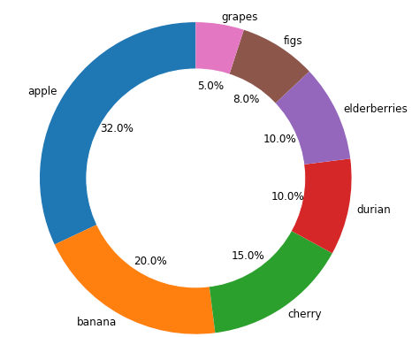
Donut Chart
A donut chart is a variant of the pie chart, with a blank center allowing for additional information about the data as a whole to be included. This type of circular graph can support multiple statistics at once and it provides a better data intensity ratio to standard pie charts. It does not have to contain information in the center.

Slide 43
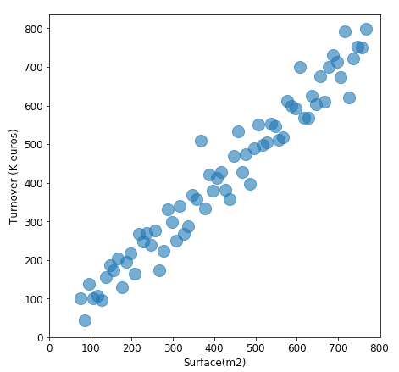
Scatter Plot
A scatter plot (also called a scatter graph, scatter chart, scattergram, or scatter diagram) is a type of plot or mathematical diagram using Cartesian coordinates to display values for typically two variables for a set of data.
When to use it ?
Scatter plots are used when you want to show the relationship between two variables. Scatter plots are sometimes called correlation plots because they show how two variables are correlated.

Slide 44
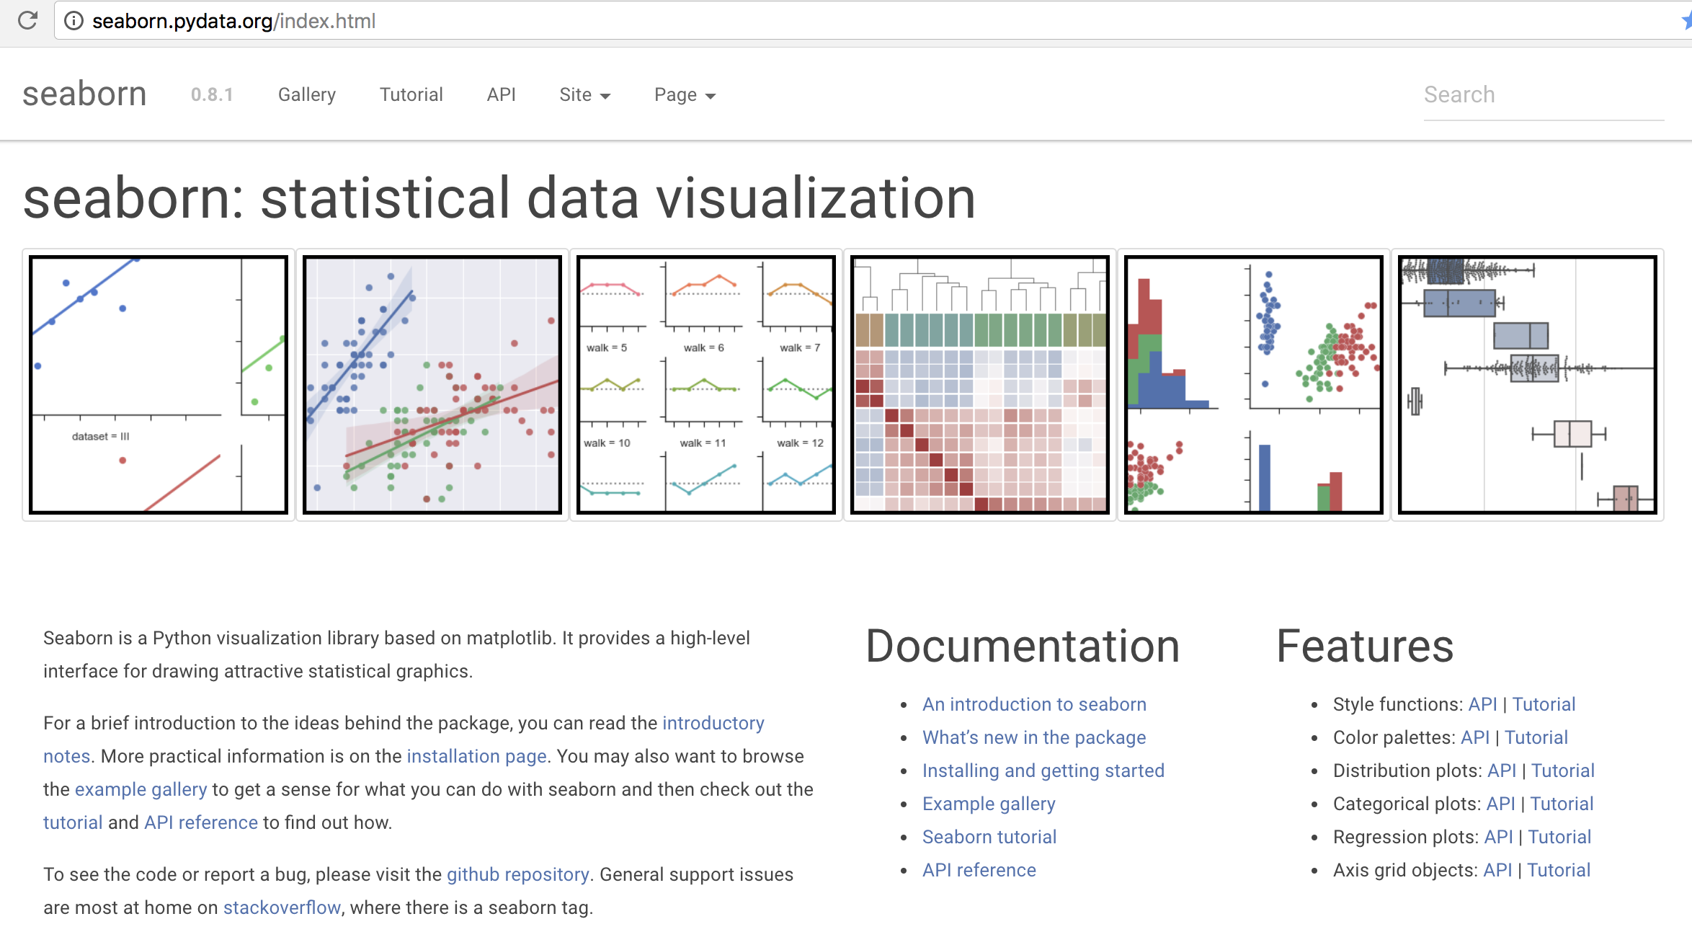

Slide 45
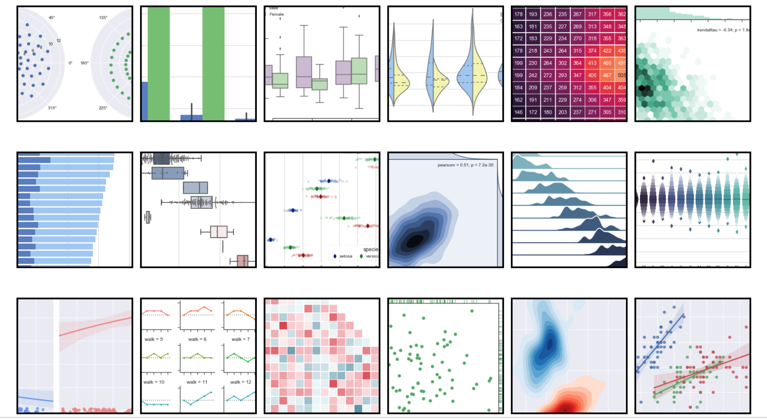
Assignment
http://seaborn.pydata.org/index.html#

Slide 46
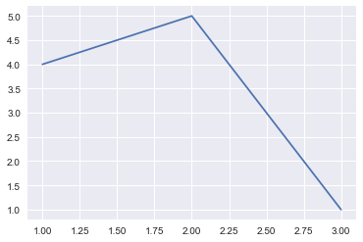
First Plot
from matplotlib import pyplot as plt
plt.plot([1,2,3],[4,5,1]) #Plotting to our canvas

Slide 47
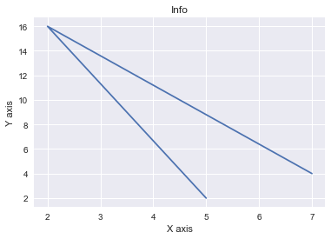
First Plot (Modify)
from matplotlib import pyplot as plt
x = [5,2,7]
y = [2,16,4]
plt.plot(x,y)
plt.title('Info')
plt.ylabel('Y axis')
plt.xlabel('X axis')

Slide 48
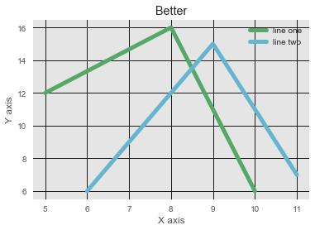
First Plot (Modify)
from matplotlib import pyplot as plt
from matplotlib import style
style.use('ggplot')
x = [5,8,10]
y = [12,16,6]
x2 = [6,9,11]
y2 = [6,15,7]
plt.plot(x,y, 'g', label='line one', linewidth=5)
plt.plot(x2,y2, 'c', label='line two', linewidth=5)
plt.title('Better')
plt.ylabel('Y axis')
plt.xlabel('X axis')
plt.legend()
plt.grid(True, color='k')

Slide 49
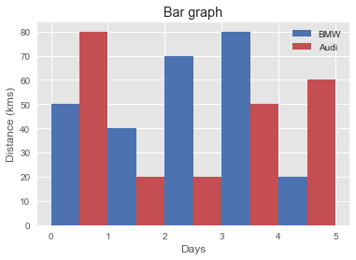
Bar Graph
from matplotlib import pyplot as plt
plt.bar([0.25,1.25,2.25,3.25,4.25],[50,40,70,80,20],
label="BMW", color='b', width=.5)
plt.bar([.75,1.75,2.75,3.75,4.75],[80,20,20,50,60],
label="Audi", color='r',width=.5)
plt.legend()
plt.xlabel('Days')
plt.ylabel('Distance (kms)')
plt.title('Bar graph')
Notes:
A bar graph uses bars to compare data among different categories. It is well suited when you want to measure the changes over a period of time.

Slide 50
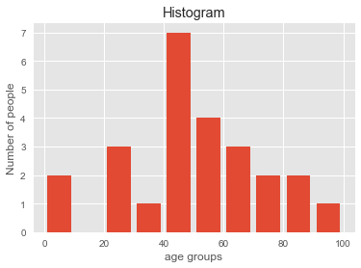
Histogram
import matplotlib.pyplot as plt
population_age =[22,55,62,45,21,22,34,42,42,4,2,102,95,85,55,110,120,70,65,55,111,115,80,75,65,54,44,43,42,48]
bins = [0,10,20,30,40,50,60,70,80,90,100]
plt.hist(population_age, bins, histtype='bar', rwidth=0.8)
plt.xlabel('age groups')
plt.ylabel('Number of people')
plt.title('Histogram')
Notes:
Histograms are used to show a distribution whereas a bar chart is used to compare different entities. Histograms are useful when you have arrays or a very long list.

Slide 51
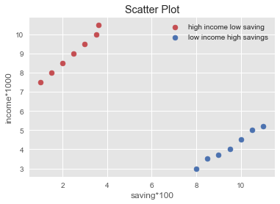
Scatter Plot
import matplotlib.pyplot as plt
x = [1,1.5,2,2.5,3,3.5,3.6]
y = [7.5,8,8.5,9,9.5,10,10.5]
x1=[8,8.5,9,9.5,10,10.5,11]
y1=[3,3.5,3.7,4,4.5,5,5.2]
plt.scatter(x,y, label='high income low saving',color='r')
plt.scatter(x1,y1,label='low income high savings',color='b')
plt.xlabel('saving*100')
plt.ylabel('income*1000')
plt.title('Scatter Plot')
plt.legend()
Notes:
Usually we need scatter plots in order to compare variables, for example, how much one variable is affected by another variable to build a relation out of it. The data is displayed as a collection of points, each having the value of one variable which determines the position on the horizontal axis and the value of other variable determines the position on the vertical axis.

Slide 52
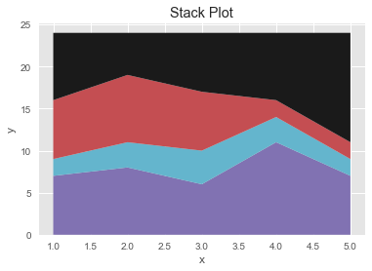
Area Plot
import matplotlib.pyplot as plt
days = [1,2,3,4,5]
sleeping =[7,8,6,11,7]
eating = [2,3,4,3,2]
working =[7,8,7,2,2]
playing = [8,5,7,8,13]
plt.plot([],[],color='m', label='Sleeping', linewidth=5)
plt.plot([],[],color='c', label='Eating', linewidth=5)
plt.plot([],[],color='r', label='Working', linewidth=5)
plt.plot([],[],color='k', label='Playing', linewidth=5)
plt.stackplot(days, sleeping,eating,
working,playing, colors=['m','c','r','k'])
plt.xlabel('x')
plt.ylabel('y')
plt.title('Stack Plot')
plt.legend()
Notes:
Area plots are pretty much similar to the line plot. They are also known as stack plots. These plots can be used to track changes over time for two or more related groups that make up one whole category.

Slide 53
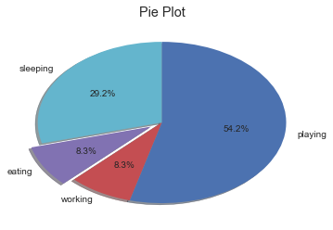
Pie Chart
import matplotlib.pyplot as plt
days = [1,2,3,4,5]
sleeping =[7,8,6,11,7]
eating = [2,3,4,3,2]
working =[7,8,7,2,2]
playing = [8,5,7,8,13]
slices = [7,2,2,13]
activities = ['sleeping','eating','working','playing']
cols = ['c','m','r','b']
plt.pie(slices,
labels=activities,
colors=cols,
startangle=90,
shadow= True,
explode=(0,0.1,0,0),
autopct='%1.1f%%')
plt.title('Pie Plot')
Notes:
A pie chart refers to a circular graph which is broken down into segments i.e. slices of pie. It is basically used to show the percentage or proportional data where each slice of pie represents a category.

Slide 54
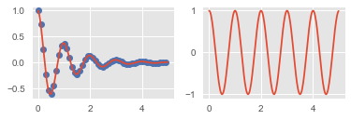
Multiple plots
import numpy as np
import matplotlib.pyplot as plt
def f(t):
return np.exp(-t) * np.cos(2*np.pi*t)
t1 = np.arange(0.0, 5.0, 0.1)
t2 = np.arange(0.0, 5.0, 0.02)
plt.subplot(221)
plt.plot(t1, f(t1), 'bo', t2, f(t2))
plt.subplot(222)
plt.plot(t2, np.cos(2*np.pi*t2))
Notes:
The subplot() command specifies numrow, numcol, fignum which ranges from 1 to numrows*numcols. The commas in this command are optional if numrows*numcols<10. So subplot (221) is identical to subplot (2,2,1). Therefore, subplots helps us to plot multiple graphs in which you can define it by aligning vertically or horizontally.

